Slide 1
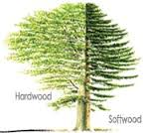
Hardwoods and Softwoods- Material Properties
Lesson Objective: To increase my knowledge and of natural materials and identify individual types through both visual appearance and touch and understand their unique properties.
TASK: Produce a detailed analysis of Hardwoods and Softwoods understanding the composition, structure and properties of the material. Produce 2 information slides full of imagery and detail explaining the different categories of natural timber.
Research Information Requirements:
Definition of a Hardwood and Softwood
Highlight and find different types of Hardwood and Softwoods
Imagery- Show examples of the material
Uses- What the specific materials used for? And explain why ?
Cost- Which material costs more and why?
How long does it take for Hardwood and Softwood to grow?
Find me a fact about Natural Timbers that I am not aware of?
Extension Task: Research and identify as man different types of MAN-MADE timbers and describe their individual functionality, use and methods of production

Slide 2
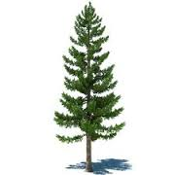
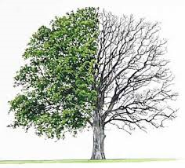
Hardwoods and Softwoods- Material Properties
Record as many possible facts about natural timbers as you can? The more information the questions you can research? Good look- work together to highlight as many answers as possible
Hardwoods? Softwoods?

