Slide 1
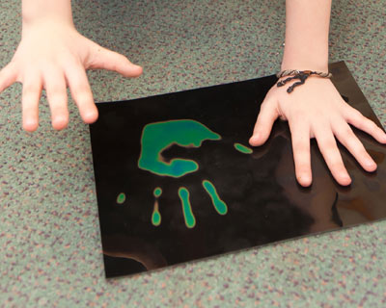
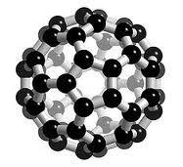
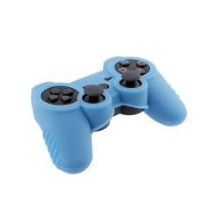
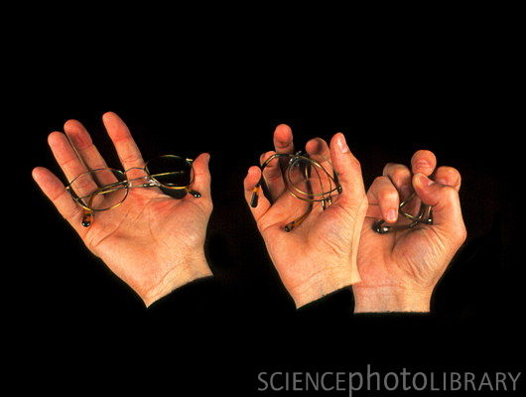
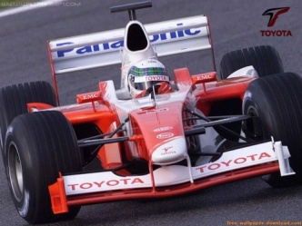
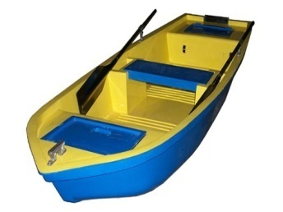
Name.........................................
Form..........................................
Teacher.......................................
Composites and Smart Materials
Starter Task
What is the definition of a ‘Smart’ Material?
..............................................................................................................................................................................................................................................................................................
List Five individual Smart Materials that have been created within the last 20yrs?
......................................................................................................................................................................................................................
What advantages have Smart Materials given to industry and the development of new innovative products?
............................................................................................................................................................................................................................................................................................................................................................................................................................................
Label the images below highlighting what Smart Material have been used to manufacture of that product?
SMART MATERIALS- Silicon Carbon Fibre Shape Memory Alloy Glass Reinforced Plastic
Useful www.Sites=Smart materials within design and technology-
Visual aid www.youtube-smart materials

Slide 2
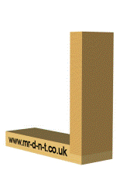
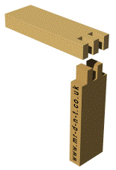
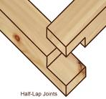
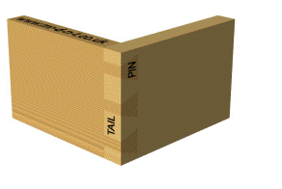
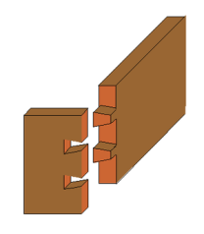
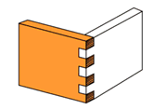
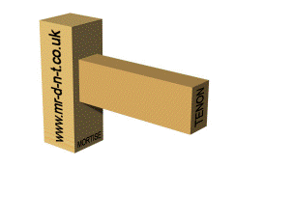
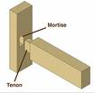
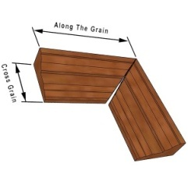
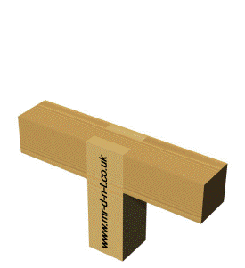
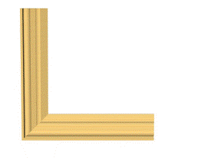
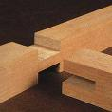
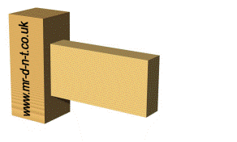
Joints Fabrication Research
Support Sheet- Use the visual designs and explanations below to complete your joint Fabrication task
Lap joint
Comb finger
Mortise and tennon
Dove tail
Mortise-and-tenon joints are among the strongest joints in woodworking, and are used for projects that have frame construction and need to be strong. Chairs and tables use them as does most Arts and Crafts and Mission style furniture.
Mitre joint
Bridle joint
Double dowel joint
A butt joint is a joinery technique in which two members are joined by simply butting them together. The butt joint is the simplest joint to make since it merely involves cutting the members to the appropriate length and butting them together. It is also the weakest because unless some form of reinforcement is used (see below) it relies upon glue alone to hold it together. Because the orientation of the members usually present only end grain to long grain gluing surface, the resulting joint is inherently weak.
A mitre or mitre joint (mitre in British English) is a joint made by bevelling each of two parts to be joined, usually at a 45° angle, to form a corner, usually a 90° angle. It is often used in making picture frames.
A bridle joint is a woodworking joint, similar to a mortise and tenon, in that a tenon is cut on the end of one member and a mortise is cut into the other to accept it. The distinguishing feature is that the tenon and the mortise are cut to the full width of the tenon member.

Slide 3
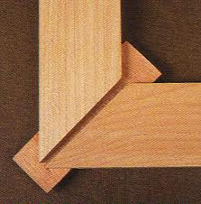
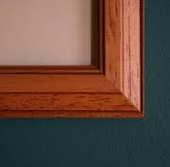
Joints Research-Traditional Wood working Joints
NAME:...................................
Teacher:.................................
Research a range of traditional wood working joints listed, produce a sketched diagram/image of the specific woodworking joint including a detailed description of how and where that specific joint would be used. Select an appropriate product displaying where the joint had been incorporated. Look at the completed example below.
Mitre Joint
Product Image-Picture Frame
Mitre Joints are similar to Butt Joints but mitre joints are more difficult to cut and are feature joints and give an attractive visual characteristic
Dowel Joint
Product
Description-
Comb Joint
Product
Description-
Mortise+Tennon Joint
Product
Description-

Slide 4
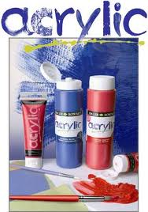
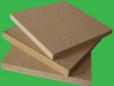
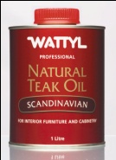
Name...................................
Form....................................
Teacher................................
Finishes Analysis
MDF
Acrylic paint comes in a large variety of colours and can be easily applied to all types of materials, however it detracts when added to natural materials such as softwoods and hardwoods as disguises and covers the natural grain of the material
Finish Type
Description/Definition for use of purpose
Preferred Material Use
Oil Based Finish
Clear Varnish Based Finish
Stain Based Finish
Spray Based Finish
Q1- What type of finish would be most appropriate for enhancing the natural grain of a material?
...............................................................................................................................................................................................................................
Q2- What advantages does stain give less expensive materials?
...............................................................................................................................................................................................................................

