Slide 1
French Learning Menu
‘LANGUAGES FOR ALL, LANGUGAES FOR LIFE’ Choose a project to complete and if you can, send evidence to prove you’ve completed it- this might be a photograph, a video, a PowerPoint presentation, a summary of what you have learnt. If you have any questions please email your teacher
1. Find a French song on Youtube and learn the lyrics. | 2. Change your phone language to French. | 3. Research a French recipe - Make it if you can, take a photo and write an opinion about it. | 4. Download Duolingo and study French for 10 minutes a day. | 5. Visit the a famous French museum: ‘The Louvre’ https://www.louvre.fr/departements Write about which paintings you liked. | 6. Watch a French film on Netflix- you can use subtitles. You can change Children’s films into French. Write a review in English.
7. Go to the Youtube channel Disney.Fr. Explore and learn a Disney song in French. | 8. Learn French through a Podcast: https://radiolingua.com/tag/cbf-season-1/?order=asc | 9. After 4pm use this learning website for free: http://zut.languageskills.co.uk/index.html | 10. Watch a topical news video from and summarise the key points in English https://www.1jour1actu.com/ | 11. Write mini presentations on the topics you have studied so far. | 12. Create a worksheet on a specific topic you have studied
13. Teach some French vocabulary to a sibling/family member. | 14. Learn the lyrics to French songs https://lyricstraining.com/fr/?fbclid=IwAR1lGcXTS8G1iwaXxikyA2G5O5u7n1CkaXao7QKdkRRBHd6dPE0nAiTvnYY | 15. Research a French speaking (not France) country and produce a presentation all about it. | 16. Make flashcards for vocabulary from a topic- use pictures to help. | 17. Listen to a French playlist on Spotify: https://open.spotify.com/playlist/7e0Q2LaJvNiPjSKTTIwuJc?si=acuRU1eWQBOZ98QHAsQDTQ | 18. Record yourself speaking French on a video. Present about the topics you’ve learnt recently.
19. Learn some French tongue twisters: https://www.youtube.com/watch?v=75w02E-PyZ4 | 20. Create a quiz on Kahoot about a French topic. Use your Knowledge Organiser to help. | 21. Watch a Children’s show in French. E.g. Pepper Pig (you can turn on the subtitles) Write down any words you recognise: https://www.youtube.com/channel/UCgoAuhyV6QMenv41aiBO3bg | 22. Research Careers that you could do with a GCSE in French- Produce a Presentation about them. | 23. Learn new vocabulary through Quizlet. https://quizlet.com | 24. Research a festival and how it’s celebrated in France and how it’s different to the UK: Easter, Christmas, Mardi Gras, Pancake day.

Slide 2
25. Text or Whatsapp a friend in your class in French. | 26. Have a look at these French fast-food websites. Have a look at the ingredients What would you order? Write a paragraph in French: https://www.dominos.fr/la-carte/nos-pizzas https://www.burgerking.fr/carte https://www.kfc.fr/la-carte/ | 27. Use quizlet to learn new vocabulary | 28. Research French food/dishes. Design a menu for a dinner party in French. Starter, Main course and Dessert. | 29. Design an outfit for a special occasion, label it in French and write a description. You could cut out clothes from an old magazine or newspaper | 30. Research a famous French person (film star, sports person, musician, scientist) and produce a biography in French.
31. For each letter of the alphabet find a food, adjective, place, boys name, girls name, animal in French. | 32. Design your own French town and label the places on the map. | 33. Research a famous French landmark and create a presentation: The Eiffel Tower, Sacre Coeur, Notre Dame, Arc de Triomph. | 34. Use word.reference.com to write out a shopping list in French. | 35. Research the rooms of the house in French. Draw a plan of your house and label the rooms. | 36. Read and translate some reviews on TripAdvisor for a local city https://www.tripadvisor.fr/
37. Choose a French story to Read/Listen to. You can translate the sentences to help you using the website. https://www.thefrenchexperiment.com/stories | 38. Practice your French grammar by completing the exercises online. https://www.languagesonline.org.uk/Hotpotatoes/frenchindex.html#Grammar | 39. Have a look at a map of France. Research a French city of your choice- there’s so much more to France than Paris. Create a presentation on the city. | 40. Create an opinion scale with pictures you have cut out from old magazines and news papers- write your opinions in French | 41. Create a triarama to with the rooms of your house. Research the items and label them in French- you can stick 2 or 3 together to create different rooms | Create an origami Eiffel Tower: https://www.youtube.com/watch?v=XIxGZn70MHA

Slide 3
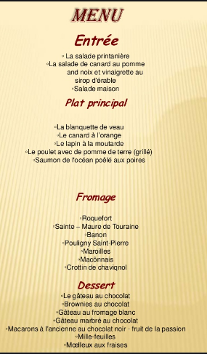
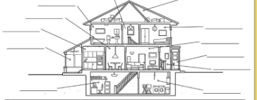
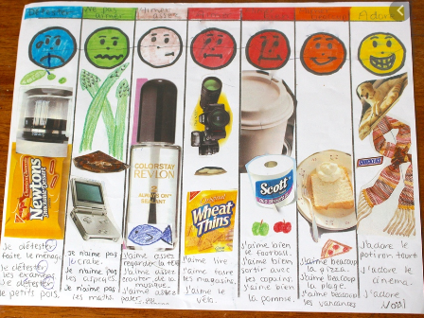
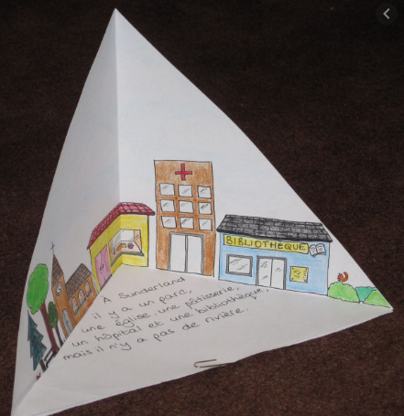
28.
32.
Lots of French labels needed
WAGOLL: What A Good One Looks Like
35.
40.
41.

