Slide 1
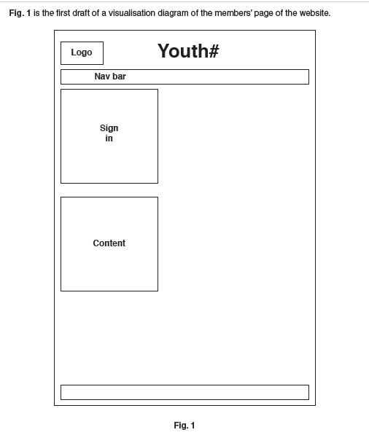
Extended Visualisation Questions

Slide 2
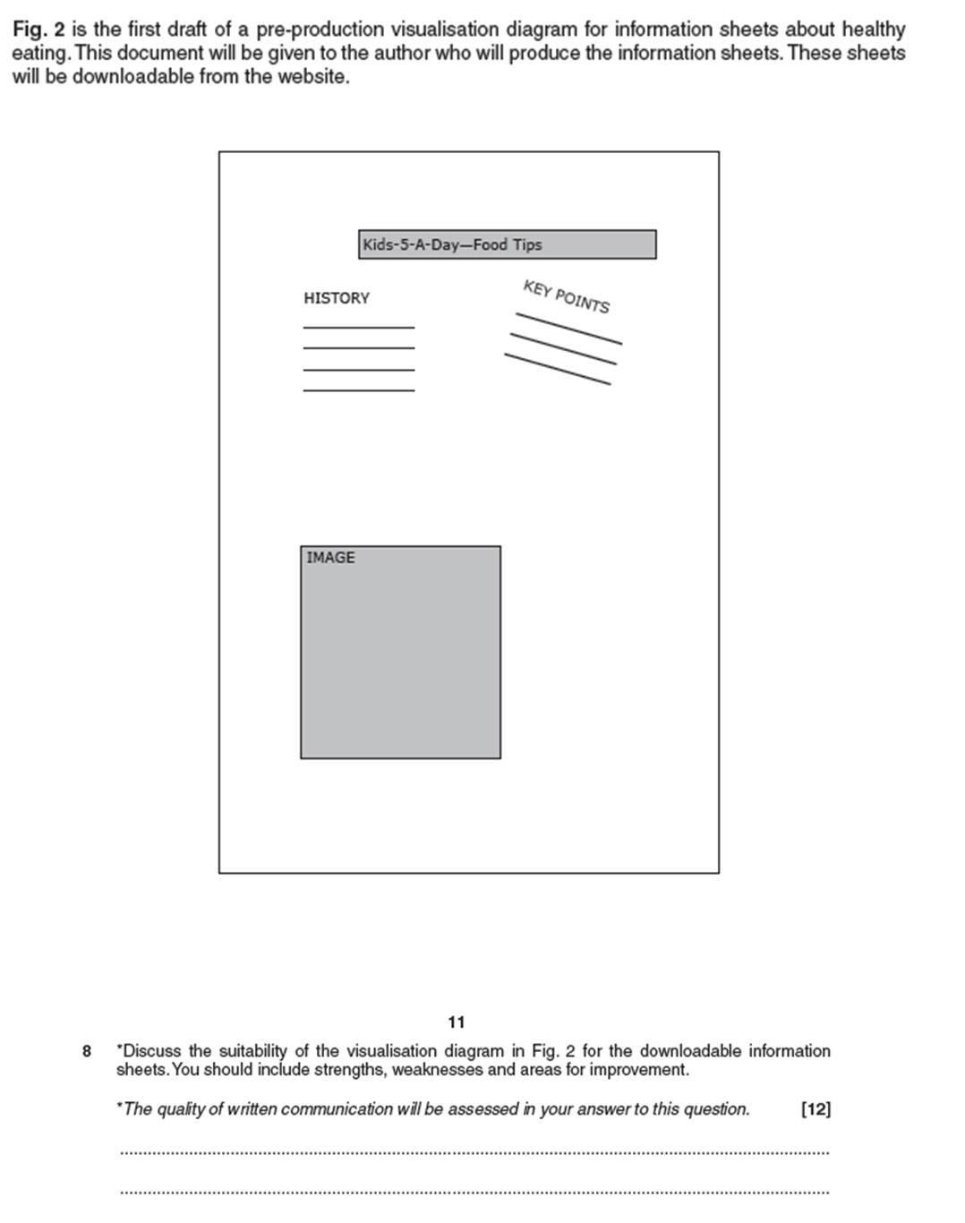
Essay Question 2

