Slide 1
Purpose and use of Visualisations
SHARE
Learning Objectives
What is the purpose and use of a visualisation?
Key Words
Mind map
Purpose
content
EXPECTED PROGRESS
Be able to state the purpose and use of a visualisation
Be able to create a visualisation for a given project
BETTER THAN EXPECTED PROGRESS
Self assess and evaluate a visualisation

Slide 2
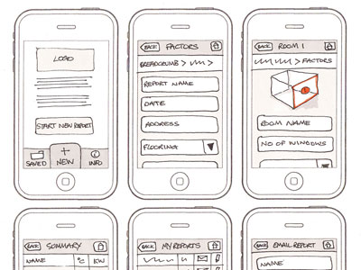
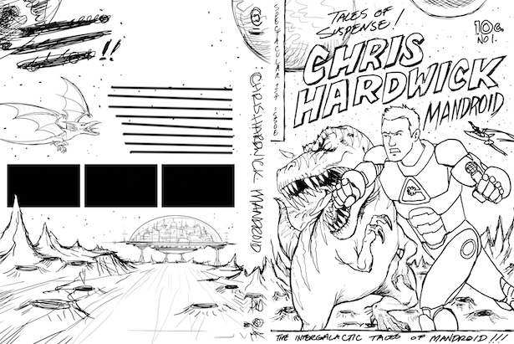
What is a visualisation?
A visualisation is a drawing created by hand or digitally showing what something will look like when created.
They are used to plan for still images or products NOT for movies or animations:
Web Pages
Graphics Eg posters/DVD covers/Magazine covers
Comics
The audience for a visualisation is always a designer NOT the actual final user or client

Slide 3
What should a visualisation include?
The layout and composition of the product (where everything goes)
An idea of the colours that will be used
Images that will be used
Logos that will be used
Text that will be used
Annotations to give information about colours, fonts and styles

Slide 4
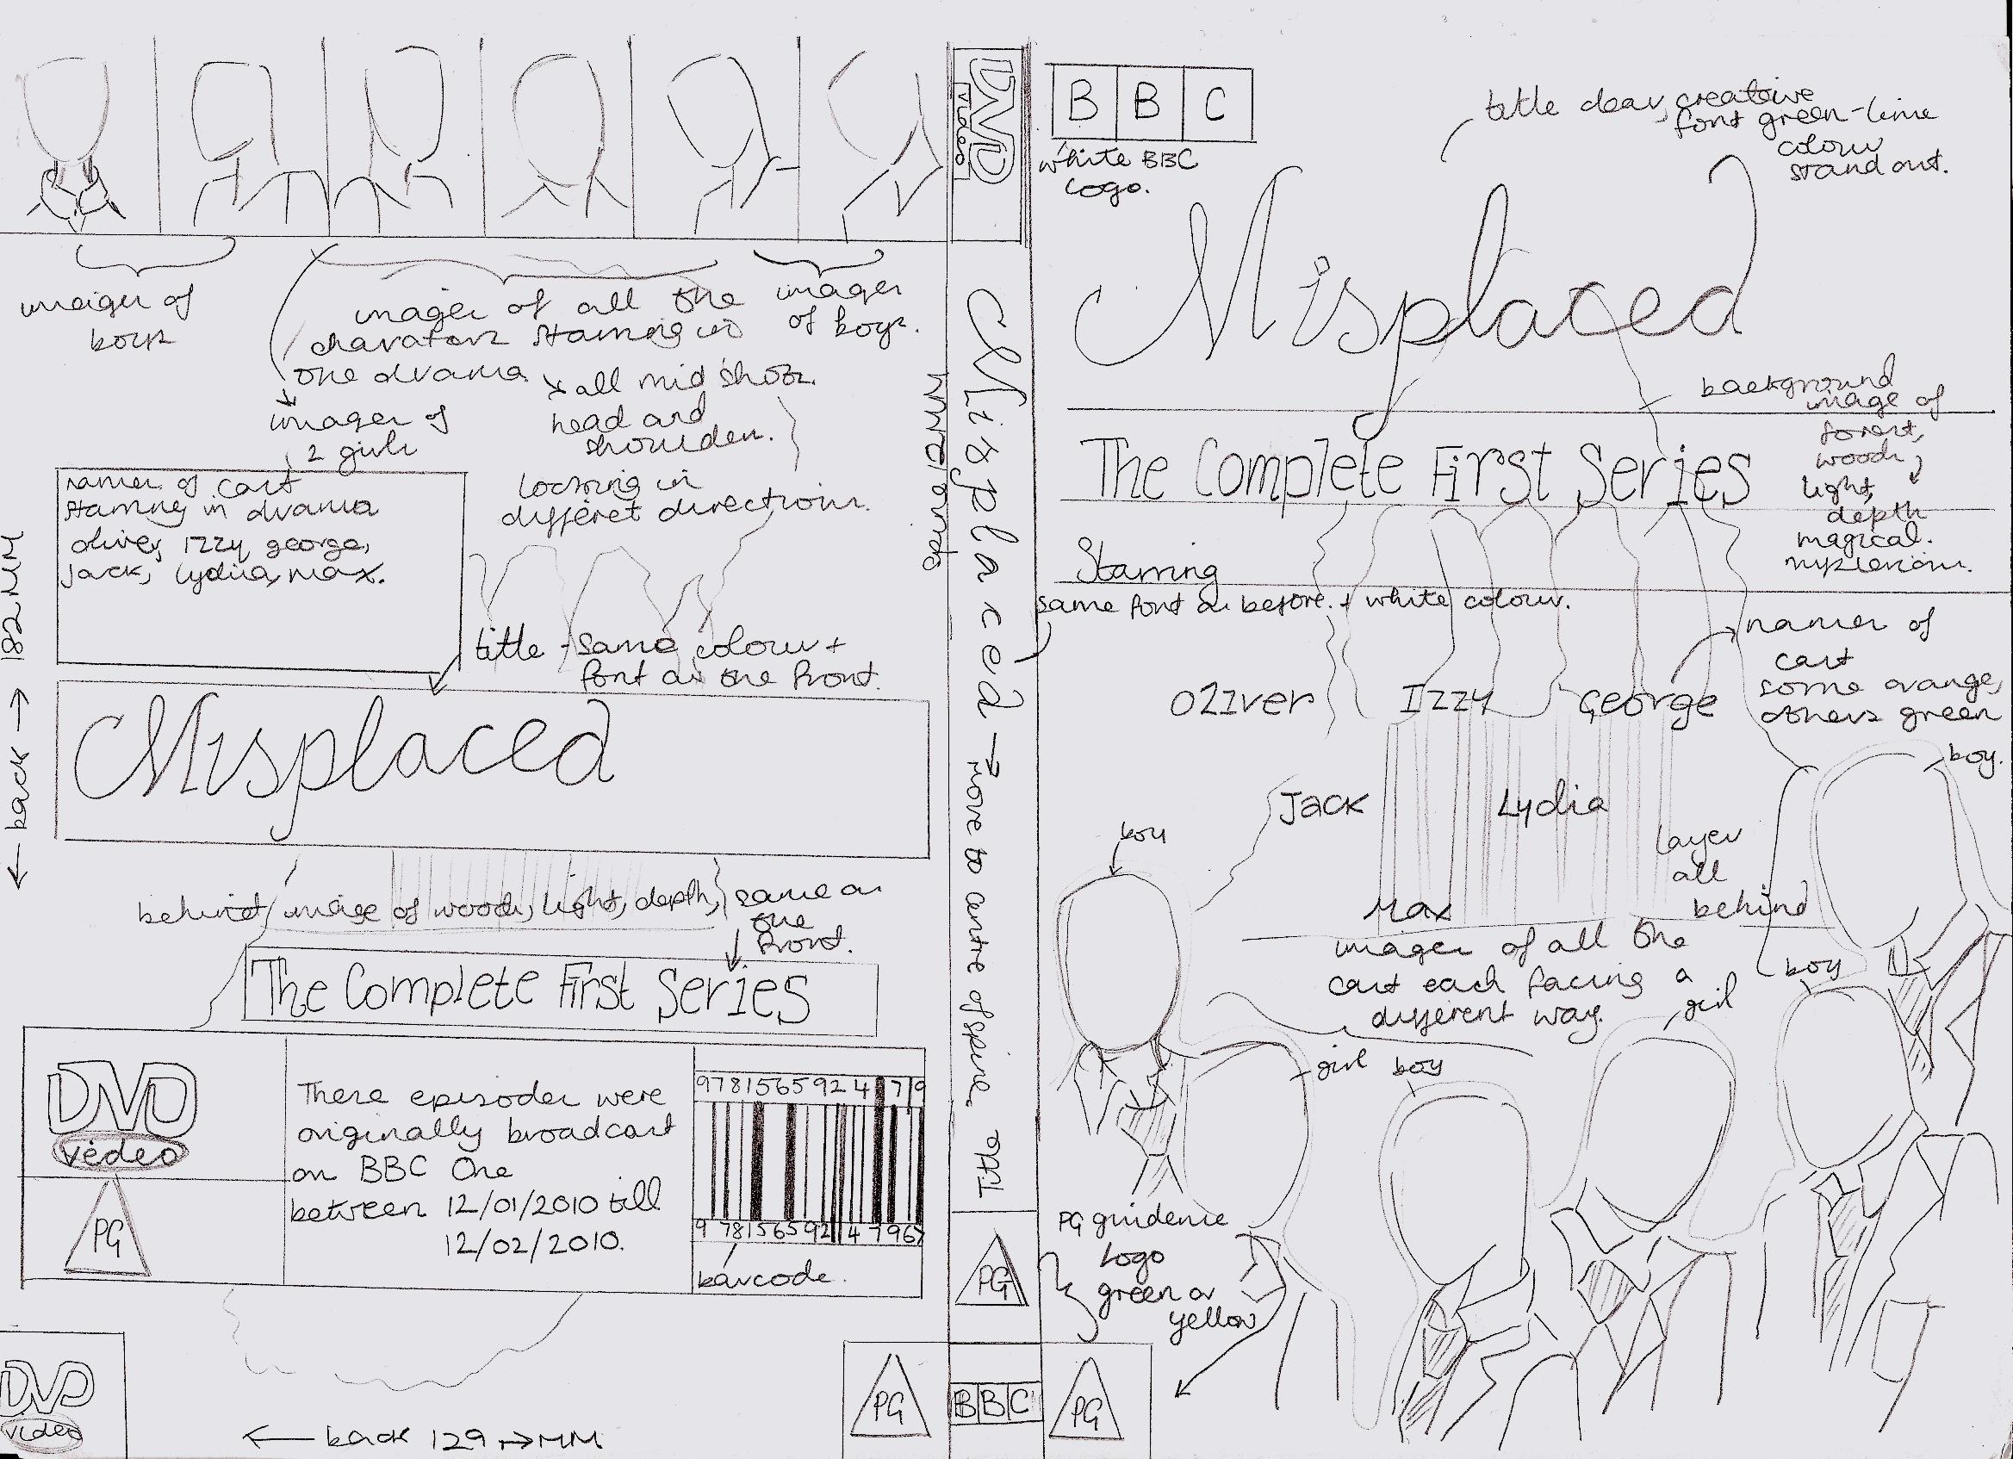
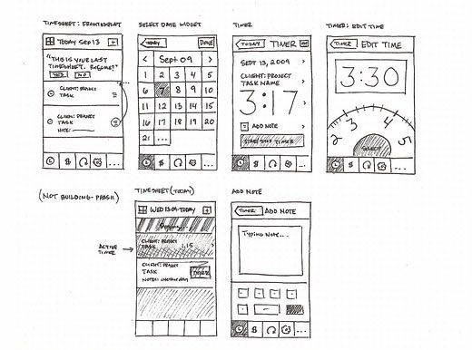
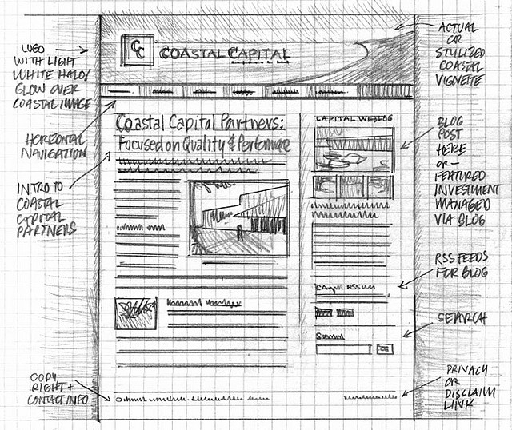
What product is this visualisation for?
LEARN
Is this visualisation suitable for its purpose?
Does it include all the necessary information?

Slide 5
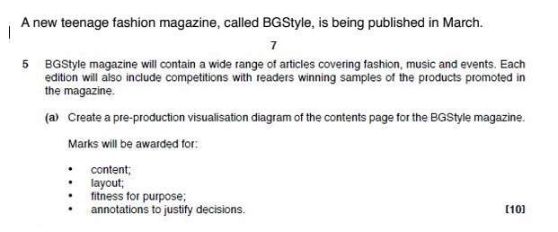
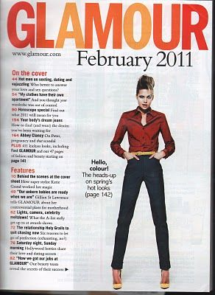
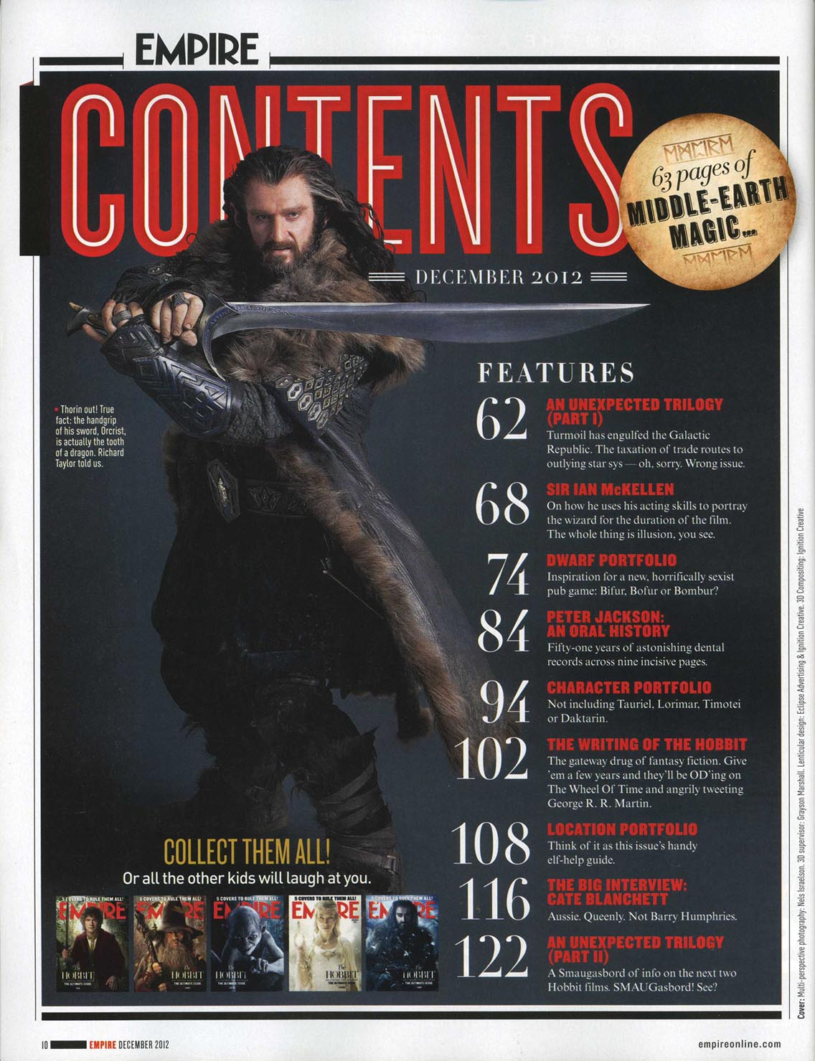

Slide 6
Extension
In your book answer the following questions in full sentences
Thinking about visualisations, answer the following in detail:
What is the purpose?
Where are they used?
What goes onto it?

Slide 7
Plenary
Write down 3 sentences to summarise your learning for today.

