Slide 1
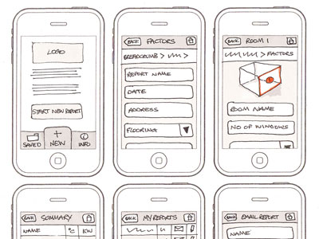
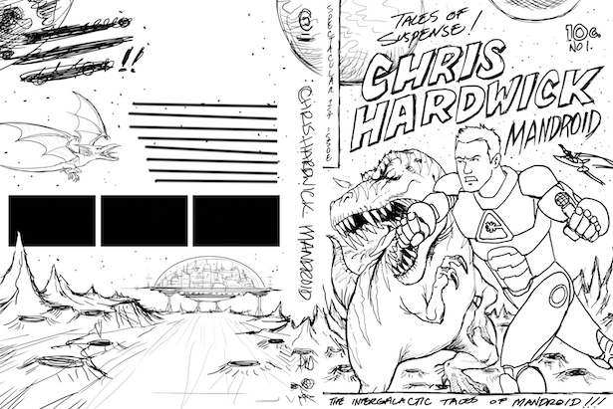
Recap Questions
ENGAGE
What is a visualisation?
What type of projects do we use a visualisation for?
What kind of information can we include in a visualisation?

Slide 2
Purpose and use of Visualisations
SHARE
Learning Objectives
What is the purpose and use of a visualisation?
Key Words
Visualisation
Purpose
content
EXPECTED PROGRESS
Be able to answer exam questions about visualisations
BETTER THAN EXPECTED PROGRESS
Create an essay plan for extended answer questions for visualisations

Slide 3
What is a visualisation?
RECAP
A visualisation is a drawing created by hand or digitally showing what something will look like when created.
They are used to plan for still images or products NOT for movies or animations:
Web Pages
Graphics Eg posters/DVD covers/Magazine covers
Comics
The audience for a visualisation is always a designer NOT the actual final user or client

Slide 4
What should a visualisation include?
RECAP
The layout and composition of the product (where everything goes)
An idea of the colours that will be used
Images that will be used
Logos that will be used
Text that will be used
Annotations to give information about colours, fonts and styles

Slide 5
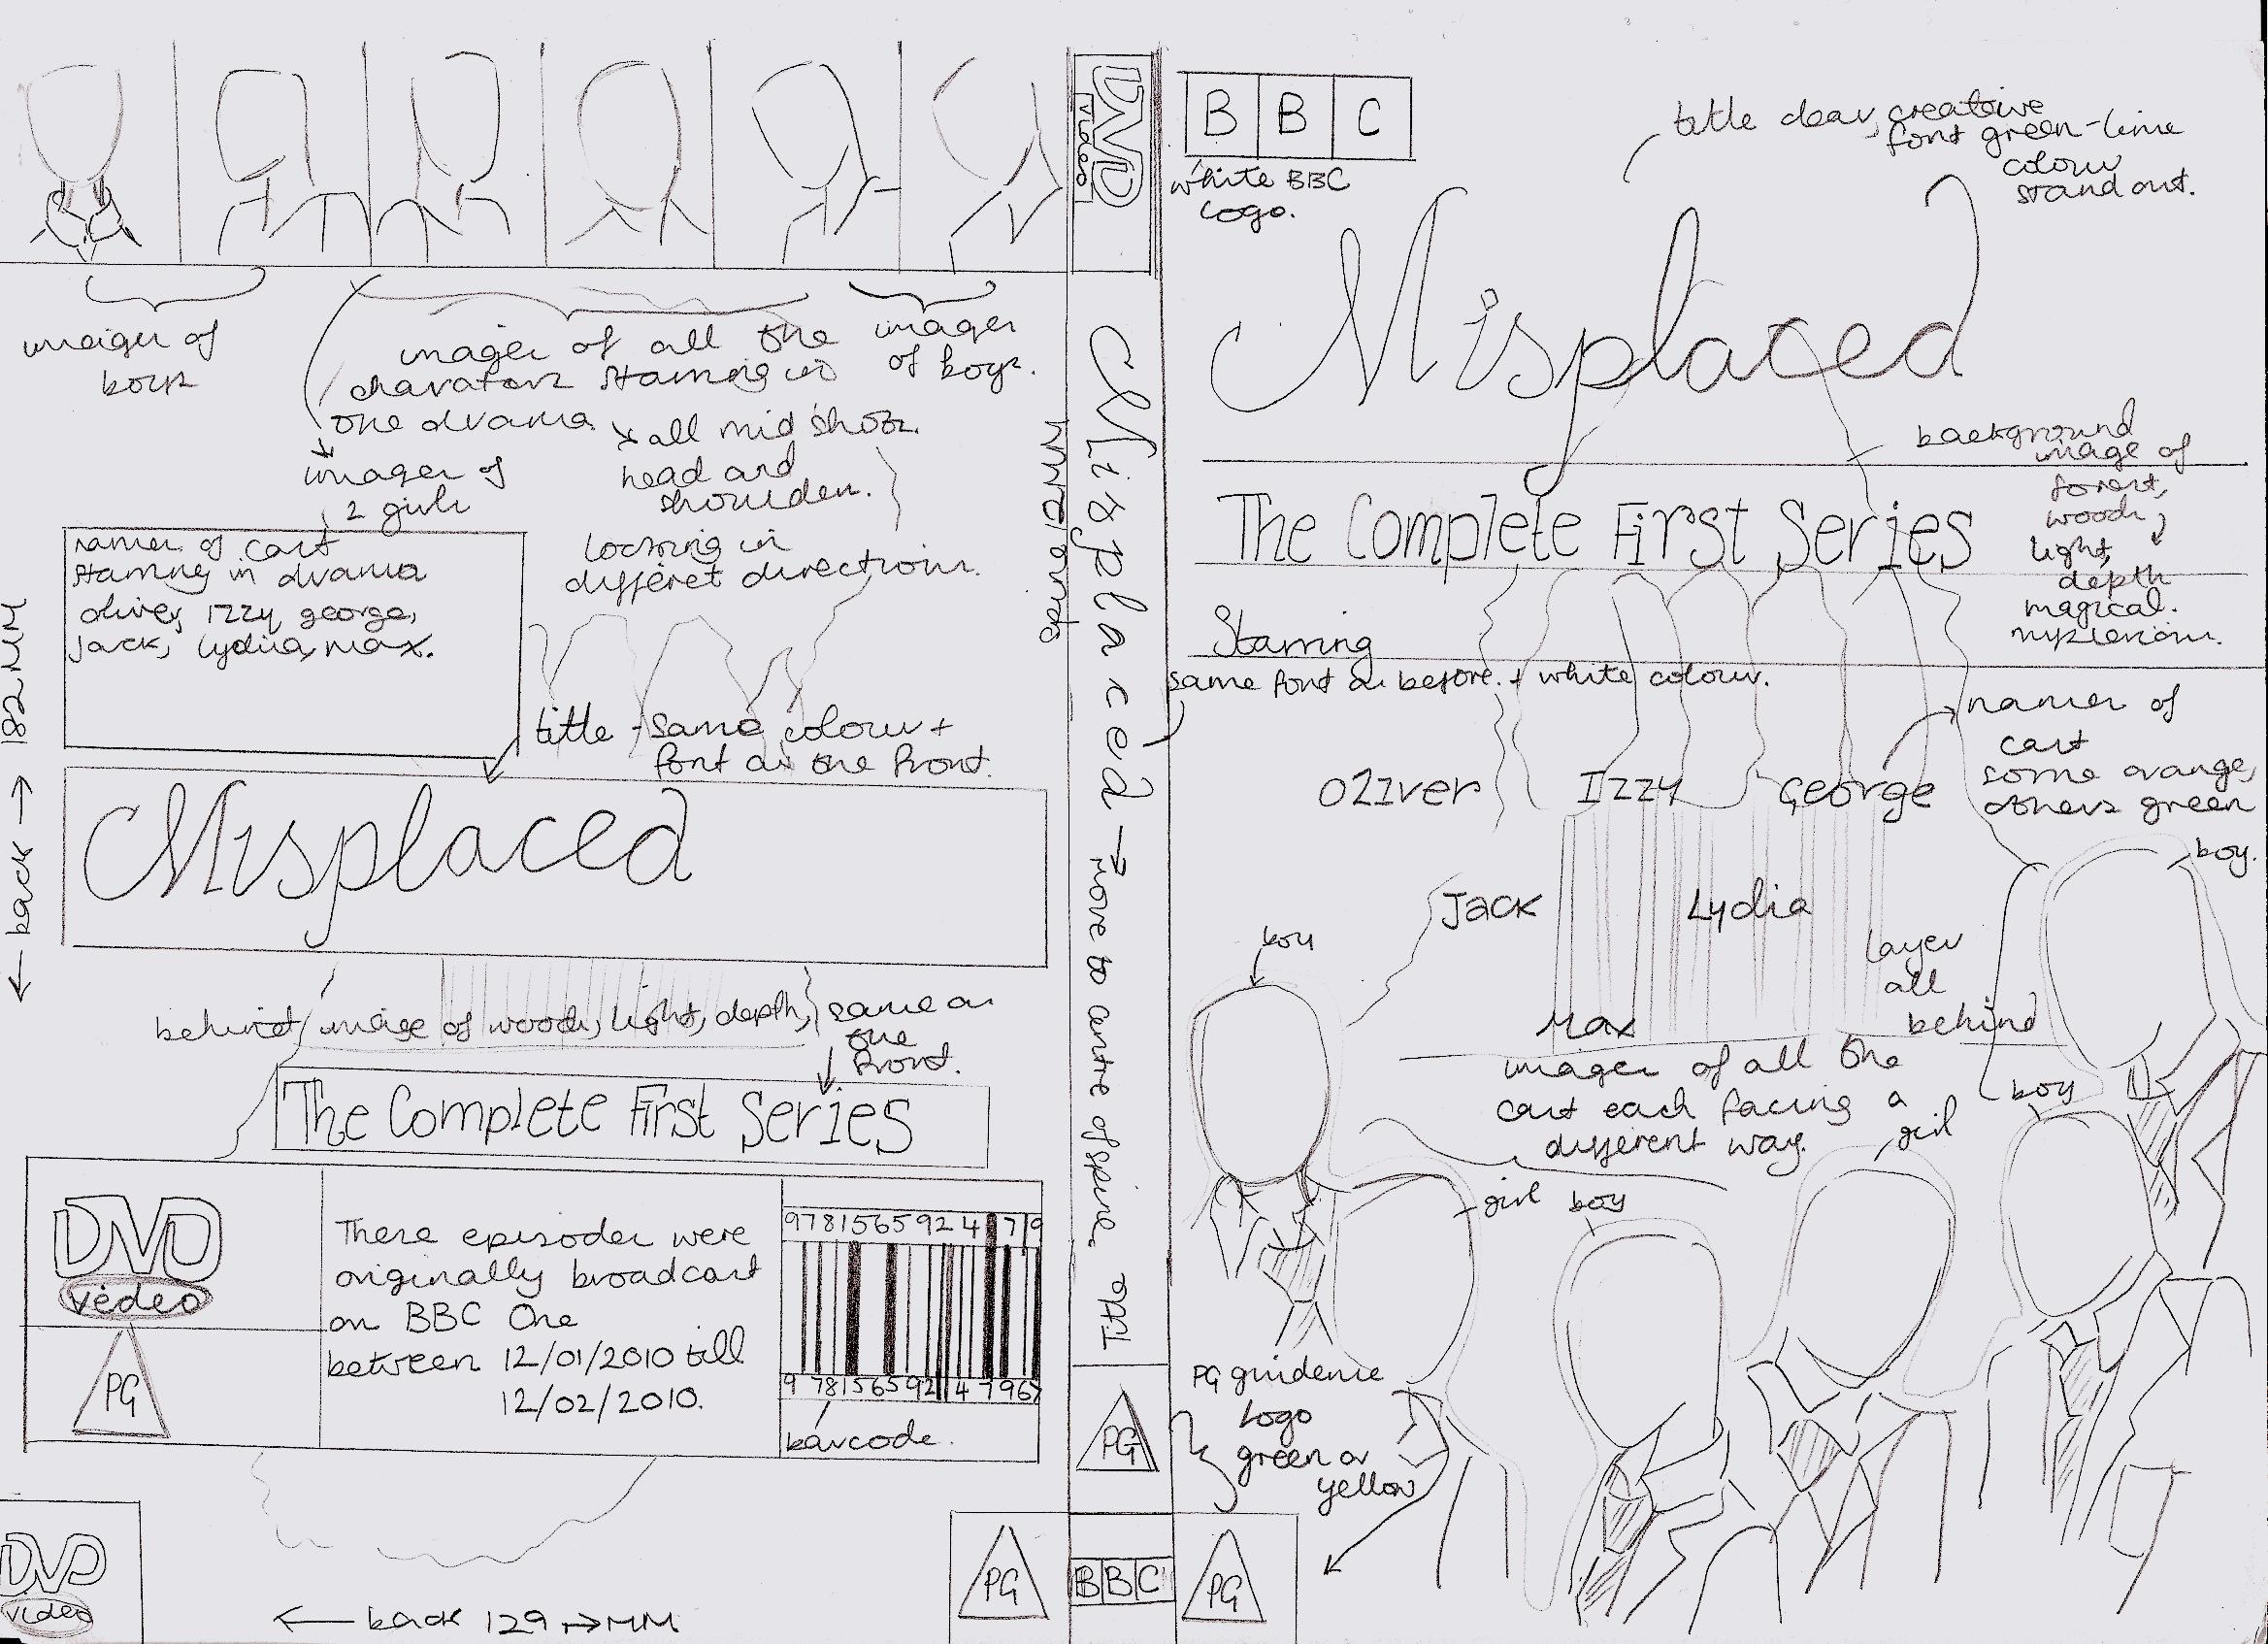
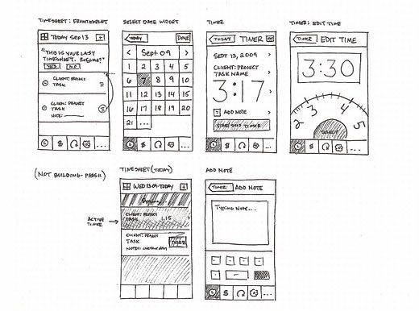
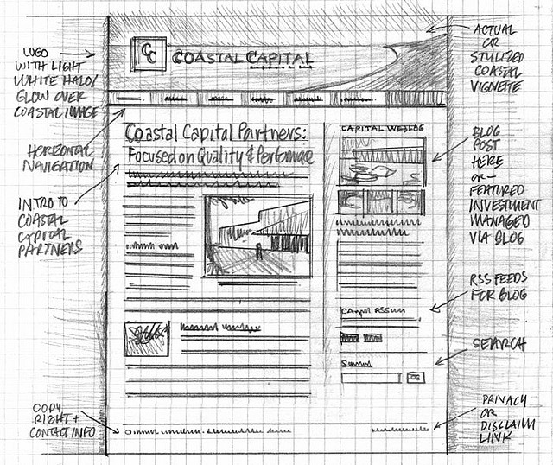
What product is this visualisation for?
LEARN

Slide 6
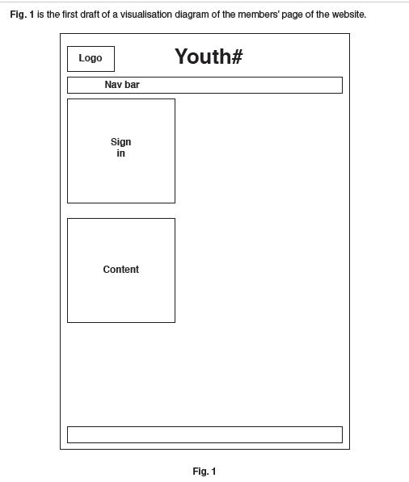
Extended Visualisation Questions
LEARN

Slide 7
Essay Plan
What is the visualisation for?
What is the purpose of a visualisation?
Who is the target audience?
Is the document suitable for the target audience (wed site designer) – To answer this question think about:
How much information is there on there that would help you make the website
Does it show the layout?
Does it give an indication of colours?
Does it give an indication of fonts and font styles?
Does it give an indication of white space (where there is empty space)? Is the white space appropriate and suitable for the purpose
Information about content (images and text)
Are annotations included?
Is it fit for purpose for a visualisation of a website?
(Remember to think of the strengths and weaknesses)
Suggest improvements (anything that is wrong needs to be improved). Explain why you suggested the improvement

Slide 8
Plenary
Write down 3 things you would need to talk about in an extended questions about visualisations

