Slide 1
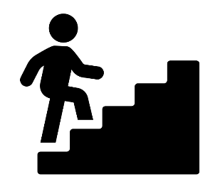
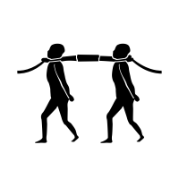
P2 American West – Conflict and Conquest
A-Levels -
Ancient History
Modern History
Classical Civilization
Law
Politics
Archeologist
Business executive
History Learning Journey
Dentist
Careers
Legal legislator
Final year 11 exams
PR
Civil Servant
P2 American West – Development of the Great Plains
Undergraduate degree
AND MANY MORE!
Diplomats
P2 American West – Early Settlement of the West
P2 – Elizabethan England – Challenges to Elizabeth
P3 Weimar & Nazi Germany – Nazi control
P3 Weimar & Nazi Germany – Hitler’s rise to power
YEAR
11
P2 – Elizabethan England – Elizabethan society
P2 – Elizabethan England – Queen, govnt and religion
P3 Weimar & Nazi Germany – Life in Nazi Germany
P3 Weimar & Nazi Germany – Weimar Germany
P1- Medicine through time – Renaissance England
P1- Medicine through time – Modern World
P1- Medicine through time – Western Front
What was the USA like in the 20th century?
YEAR
10
P1- Medicine through time – Medieval England
P1- Medicine through time – Industrial World
Key Knowledge and Skills Transfer Y9 to 10/11:
• chronology, individuals, events, developments and issues
• first order historical concepts such as ‘constitution’, ‘nation’, ‘revolution’, ‘society’
• selecting, organizing and communicating knowledge and understanding in written narratives, descriptions and analyses, reaching substantiated conclusions • Second order concepts continuity, change, cause, consequence, significance and similarity and
Why were people persecuted in Nazi Germany?
How did ‘heroes’ live in trenches?
What was life like on the Home Front?
Why do it all over again?
Why did World War One start?
Did the French really get rid of the monarchy?
YEAR
9
Why did most people in Manchester die before the age of 20?
Why did most people in Manchester die before the age of 20? Contd’
Recap of learning from year 9 in years 7 and 8
What lay behind the horrors of the Slave Trade
How did the Plains Indians lose their way of life?
Does the British Empire still impact lives?
YEAR
8
Was religion and life really a roller coaster in Tudor England?
Recap of learning from year 7 in year 8
Was life really rotten in Medieval England?
Did the World really turn upside down?
Why did the English get a French King in 1066?
How do we learn about History? Historical key skills
YEAR
7
What did the Romans do for us?
Key Stage 1 and 2 Knowledge and Key skills:
Enquiry skills. Knowledge and concepts, develop an even deeper understanding of people’s and societies.

