Slide 1
A Midsummer Night’s Dream

Slide 2
A Midsummer Night’s Dream: The brief
You are part of a theatre company and have been placed in charge of putting on a performance of A Midsummer Night’s Dream.
You will have many jobs to do:
Cast the characters
Design the settings
Design costumes
Create a theatre programme
Create a theatre poster to advertise your play

Slide 3
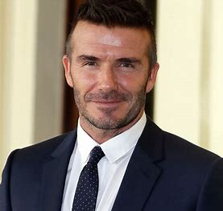
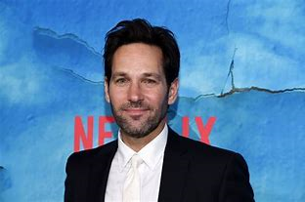
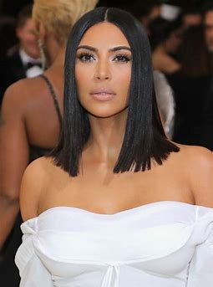
A Midsummer Night’s Dream: The characters
What characters will you need to cast? Who will you cast?
Think of each character’s personalities and which celebrities will be best suited to play that role?
Explain why you have chosen your cast choices.

Slide 4
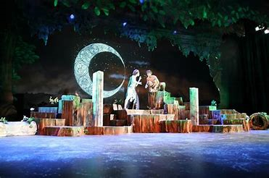
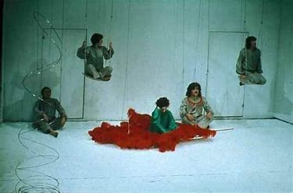
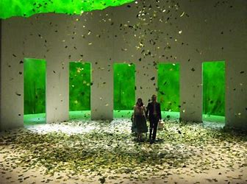
A Midsummer Night’s Dream: Design the setting
Where are you going to set it?
Shakespeare set the original in Ancient Athens
The film you may have seen set it in Italy.
What time period are you going to use? Is it going to be modern? Victorian era?
Design you stage set and explain your reasons

Slide 5
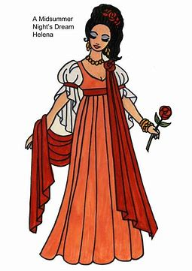
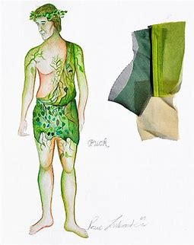
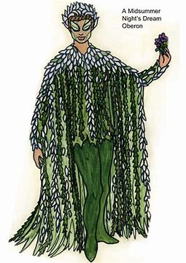
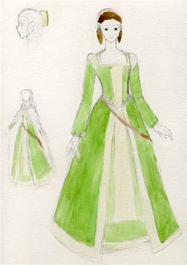
A Midsummer Night’s Dream: Costume Designs
Each character will need a costume
Think of each character’s personalities and what costume would suit their position in the play.
Explain why you have chosen your costume designs. It would be useful to annotate them.

Slide 6
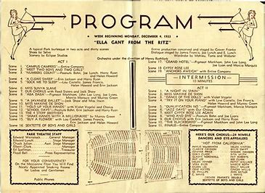
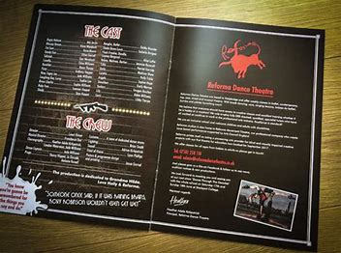
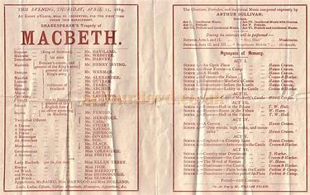
A Midsummer Night’s Dream: Theatre Programme
Who is playing each character
Name of the theatre.
Time and date of performance
Summary of the setting.
Any other relevant information you want to include
https://www.flipsnack.com/templates/theatre-program-template

Slide 7
A Midsummer Night’s Dream: Theatre Poster
Who is playing each character?
Where and when is the play on?
Brief description of the play.
Ratings and reviews

